Slide 1
Routing
ROUTING

Slide 2
Router
Routing
A router is a device that determines the next network point to which a packet should be forwarded toward its destination
Allow different networks to communicate with each other
A router creates and maintain a table of the available routes and their conditions and uses this information to determine the best route for a given packet.
A packet will travel through a number of network points with routers before arriving at its destination.
There can be multiple routes defined. The route with a lower weight/metric will be tried first.

Slide 3
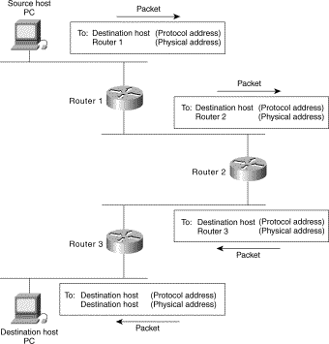
Routing
Routing

Slide 4
Routing Protocols
Routing
Static Routing
Dynamic Routing
  IGP (Interior Gateway Protocol): Route data within an Autonomous System
    RIP (Routing Information Protocol)
    RIP-2 (RIP Version 2)
    OSPF (Open Shortest Path First)
    IGRP (Interior Gateway Routing Protocol)
    EIGRP (Enhanced Interior Gateway Routing Protocol)
    IS-IS
  EGP (Exterior Gateway Protocol): Route data between Autonomous Systems
    BGP (Border Gateway Protocol)

Slide 5
Internetworking Devices
Internetworking Devices
Device | Description
Hub | Hubs are used to connect multiple users to a single physical device, which connects to the network. Hubs and concentrators act as repeaters by regenerating the signal as it passes through them.
Bridge | Bridges are used to logically separate network segments within the same network. They operate at the OSI data link layer (Layer 2) and are independent of higher-layer protocols.
Switch | Switches are similar to bridges but usually have more ports. Switches provide a unique network segment on each port, thereby separating collision domains. Today, network designers are replacing hubs in their wiring closets with switches to increase their network performance and bandwidth while protecting their existing wiring investments.
Router | Routers separate broadcast domains and are used to connect different networks. Routers direct network traffic based on the destination network layer address (Layer 3) rather than the workstation data link layer or MAC address.

Slide 6
VLAN
VLAN

Slide 7
VLANs
VLAN
VLANs (Virtual LAN) enable network managers to group users logically (based on functions, project teams or applications) rather than by physical location.
Traffic can only be routed between VLANs.
VLANs provide the segmentation traditionally provided by physical routers in LAN configuration.

Slide 8
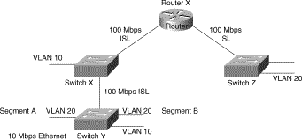
VLANs and Inter VLAN Routing
VLAN

Slide 9
Advantages of Using VLANs
VLAN
Broadcast Control— Just as switches physically isolate collision domains for attached hosts and only forward traffic out a particular port, VLANs provide logical bridging domains that confine broadcast and multicast traffic to the VLANs.
Security— If you do not allow routing in a VLAN, no users outside of that VLAN can communicate with the users in the VLAN and vice versa. This extreme level of security can be highly desirable for certain projects and applications.
Performance— You can assign users that require high-performance or isolated networking to separate VLANs.

Slide 10
TCP/UDP
TCP/UDP

Slide 11
TCP/UDP
TCP/UDP
Transport Layer Protocol
TCP is connection Oriented (uses checksum and acknowledgment)
UDP is Connectionless
Both use the concept of Connection Port Number (16 Bit Source Port Number and Destination Port Number)
Standard Applications have standard Port Numbers (Email 25, Telnet 23, FTP 20 & 21, SSH 22)

